Slide 1

TEAM 7

Slide 2







AGENDA
Today
Company & Industry overview
Business problem
Analysis approach & rub data
Findings:
Descriptive
Predictive
Insights & Recommendations

Slide 3
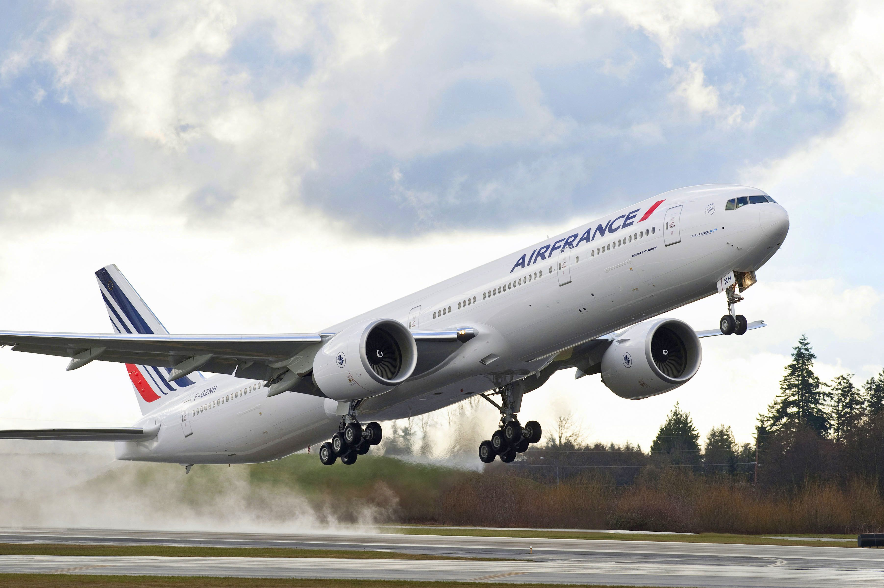






Company &
Industry Overview
DoubleClick and Kayak Data Sets
International travel as the fastest growing market
263%
increase in online bookings
SEM
Search engine optimization
Pay-per-click

Slide 4






Business problem
Decrease Costs
Boost Profit Margins
MAXIMIZE PROFITS
Increase Sales
Efficient ROA

Slide 5



Rub Data
Cleaning column names
Dealing with N/A
Length
Spaces
Flagged
Dropped
Numeric conversions
Success into binary
“Any bookings” : 1
0 : 0
Match into binary
“Advanced”: 1
Rest : 0

Slide 6
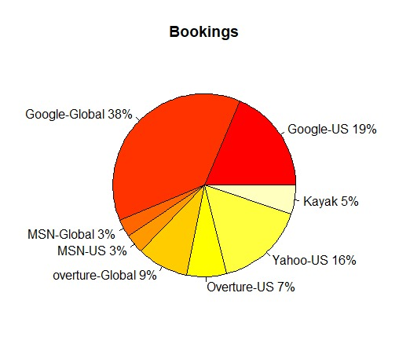
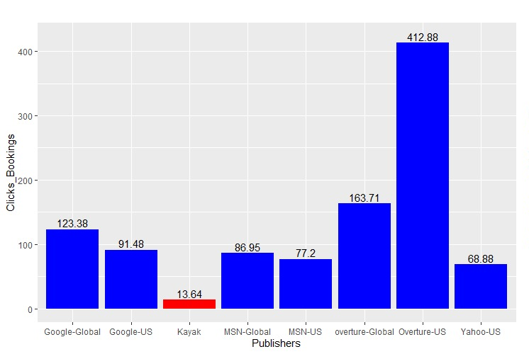
Descriptive analysis
Bookings per publisher
Clicks per booking

Slide 7
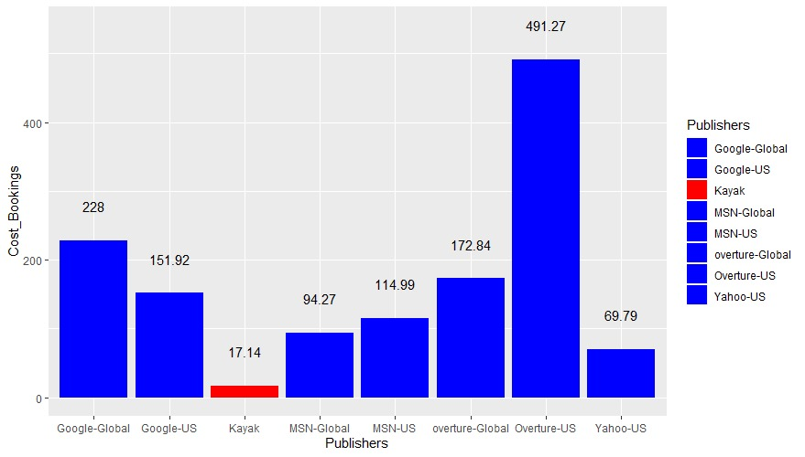
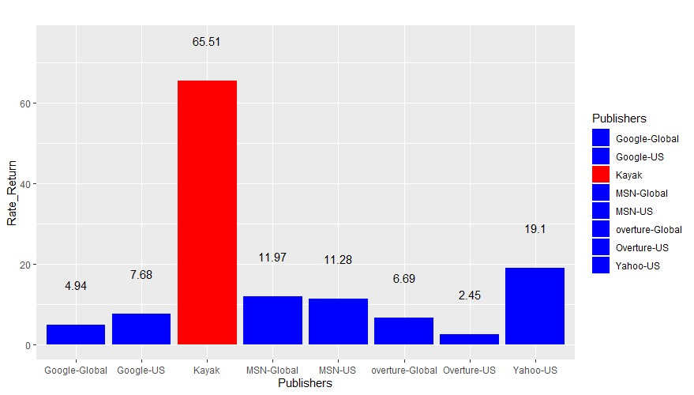
Descriptive analysis
Cost per booking
Return rate

Slide 8
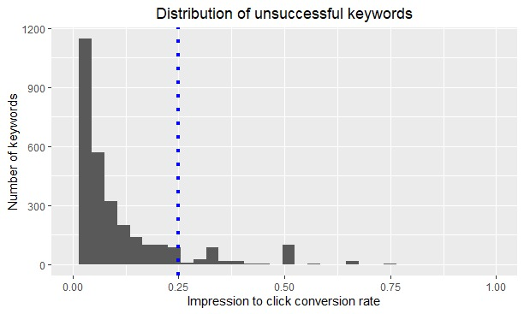
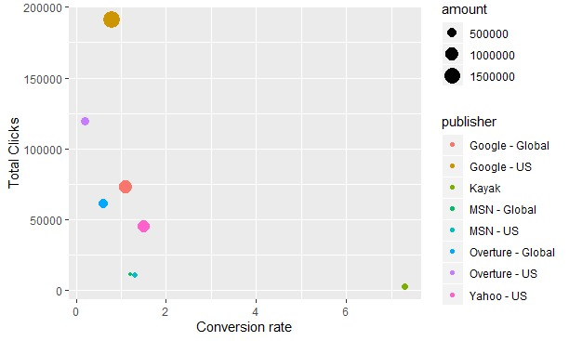
Predictive analysis
1st Approach: Conversion rate
Conversion rate to total clicks

Slide 9
Predictive analysis
1st Approach: Conversion rate
Return:
10$/1$
Cost = 2K
High
Traffic
504
280
Low
Traffic
3593
85
Return:
1.5$/1$
Unsuccess
Success
Save 187K

Slide 10
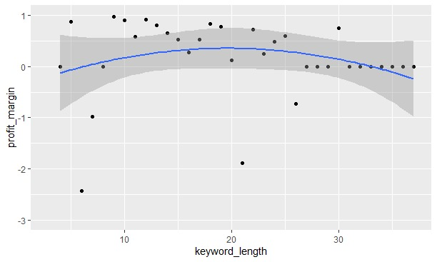
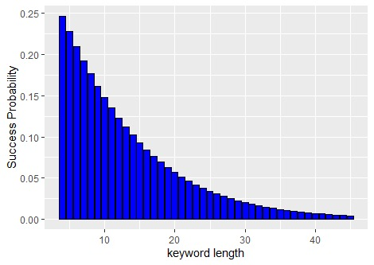
Predictive analysis
2nd Approach: Keyword optimization
1
Profit margin
2
Grouping keywords
3
Scatter plot and trend line
4
Profit margin function
y = -0.0014x ² + 0.0498x - 0.141
5
Optimize function
6
Cutoff point 17.78

Slide 11
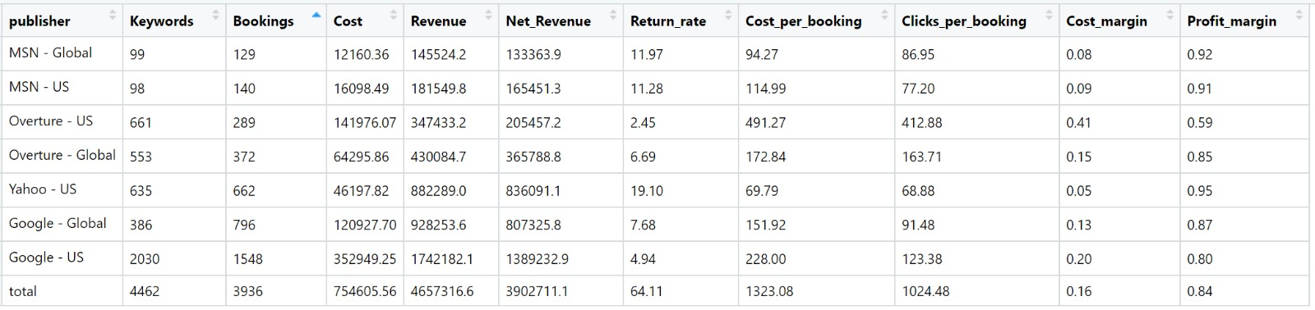
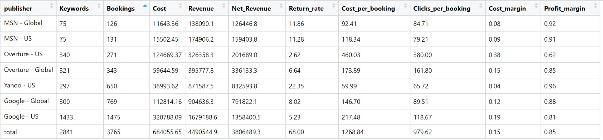
Predictive analysis
All
Keywords
Using
18 as
cutoff
point

Slide 12


Conclusion
KAYAK OVERTURE
Approach 1 for the existing keywords
Approach 2 for future keywords
Performance will improve by 4% on profit margins

Slide 13







MEET THE TEAM
Team 7
Abby
Antony
Delara
Vafaeinejad
Dongwoo
Kang
Georg
Stotzingen
Marta
Moreno
Victoria
Landa-Steinau
India
Iran
South Korea
Germany
Spain
USA

